Slide 1

Computer Programming for Engineers
Week 4 Lecture 1
Sep. 20, 2022
Lecturer: Mohammad Mahdi Javidan
College of Engineering, Sungkyunkwan University
Fall Semester 2022

Slide 2
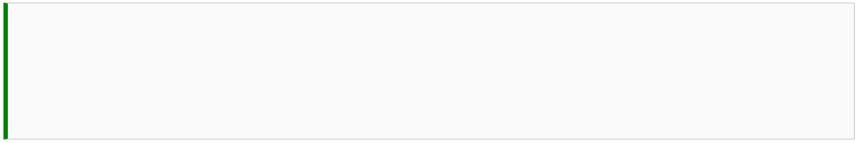
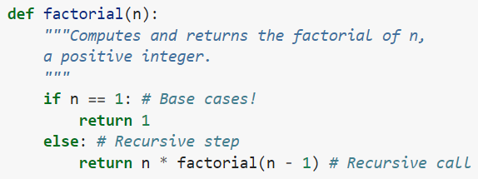
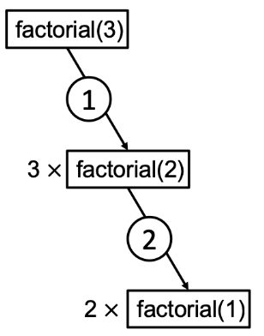

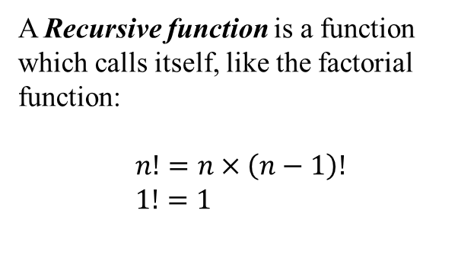
Recursion
A Recursive function is a function which calls itself, like the factorial function:
$$n!=n×\left(n−1\right)! \\ 1!=1$$
Recursive call
Base case
College of Engineering, Sungkyunkwan University

Slide 3
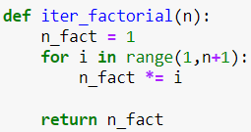
Recursion
Iterative functions are faster!
Measuring runtime using the magic command %timeit
College of Engineering, Sungkyunkwan University

Slide 4
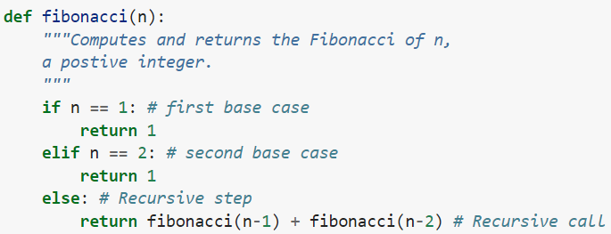
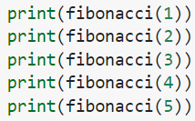
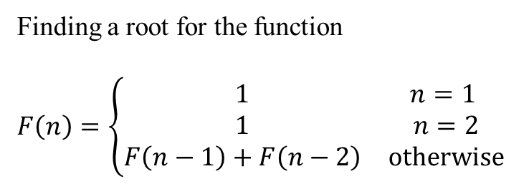
Fibonacci Numbers
Finding a root for the function
$F\left(n\right)=\left\{\begin{matrix}1 & n=1 \\ 1 & n=2 \\ F\left(n−1\right)+F\left(n−2\right) & otherwise\end{matrix}\right.$
College of Engineering, Sungkyunkwan University

Slide 5
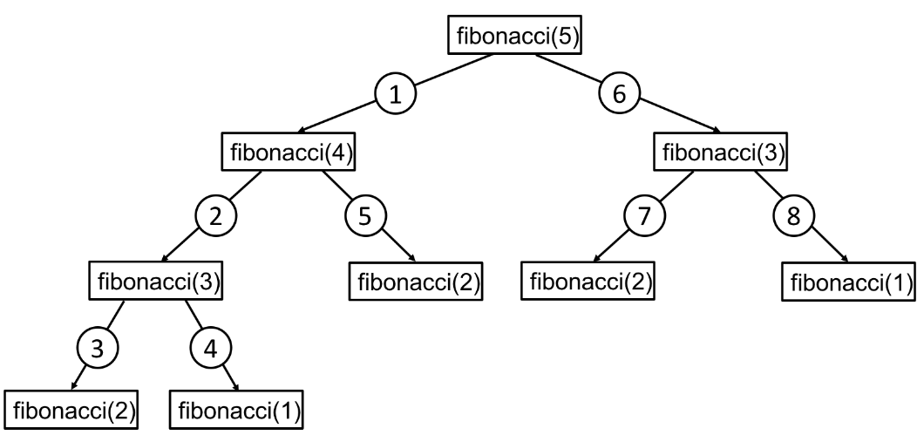
Fibonacci Numbers
College of Engineering, Sungkyunkwan University

Slide 6
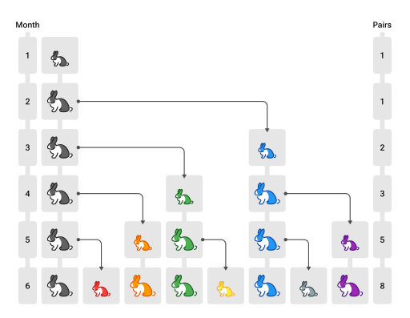
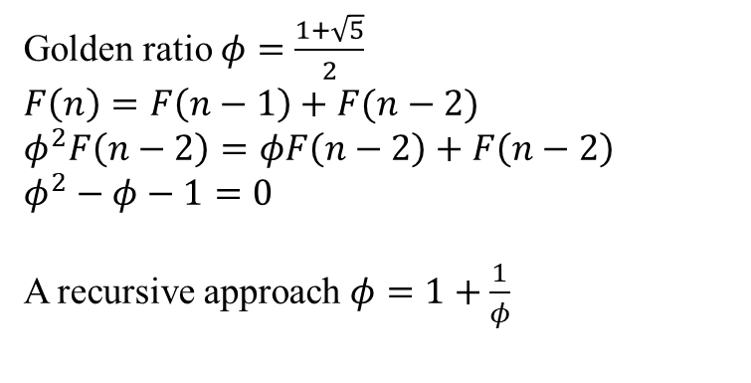
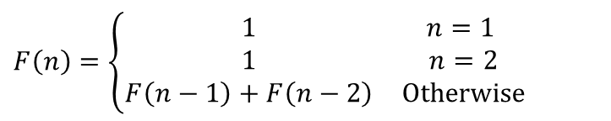
Fibonacci Numbers
Fibonacci (1202) wanted to calculate the growth rate of a hypothetical rabbit population:
There is a pair of newly born rabbits
Each pair mates after the age of 1 month
at the end of the 2nd month they always produce another pair of rabbits
Rabbits never die
$F\left(n\right)=\left\{\begin{matrix}1 & n=1 \\ 1 & n=2 \\ F\left(n−1\right)+F\left(n−2\right) & Otherwise\end{matrix}\right.$
Golden ratio $φ=\frac{1+\sqrt{5}}{2}$
$F\left(n\right)=F\left(n−1\right)+F(n−2)$
$φ^{2}F\left(n−2\right)=φF\left(n−2\right)+F\left(n−2\right)$
$φ^{2}−φ−1=0$
A recursive approach $φ=1+\frac{1}{φ}$
https://en.wikipedia.org/wiki/Fibonacci_number
College of Engineering, Sungkyunkwan University

Slide 7
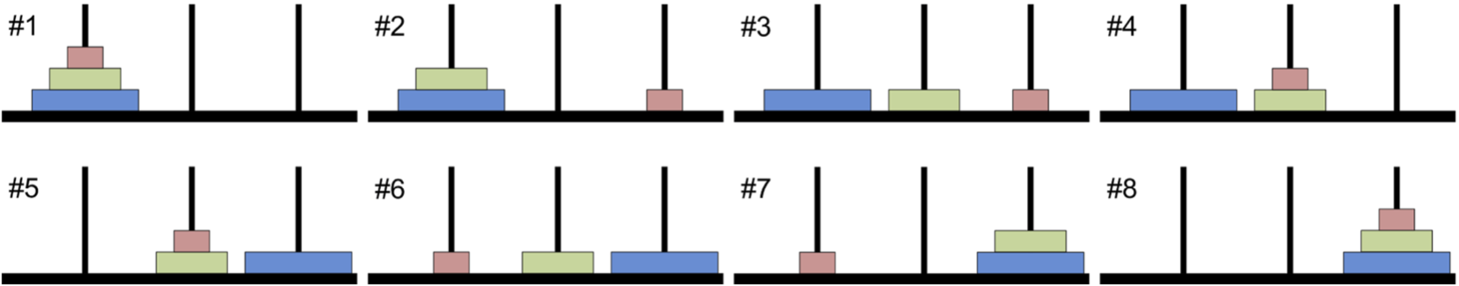
Towers of Hanoi
Or Lucas Tower. Explanation and rules:
There are three rods.
N discs are stacked in the descending order on one of the towers.
The goal is to move all the discs to a different rod
Only one disk can be moved at a time.
Only the disk at the top of a stack may be moved.
A disk may not be placed on top of a smaller disk.
This problem can be solved using the Divide and Conquer strategy which divides the problem into a simpler subproblem.
College of Engineering, Sungkyunkwan University

Slide 8
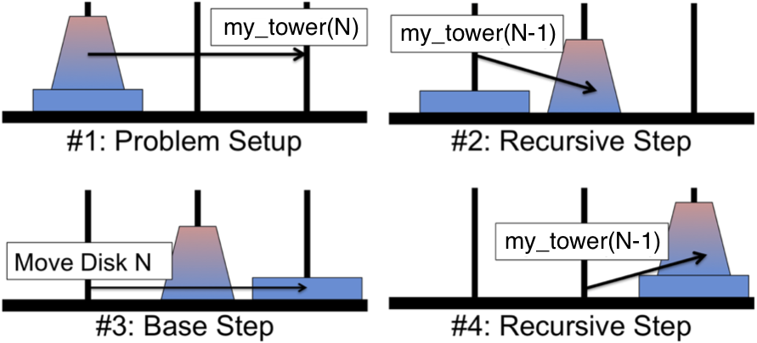
Towers of Hanoi
This problem can be solved using the Divide and Conquer strategy.
College of Engineering, Sungkyunkwan University

Slide 9
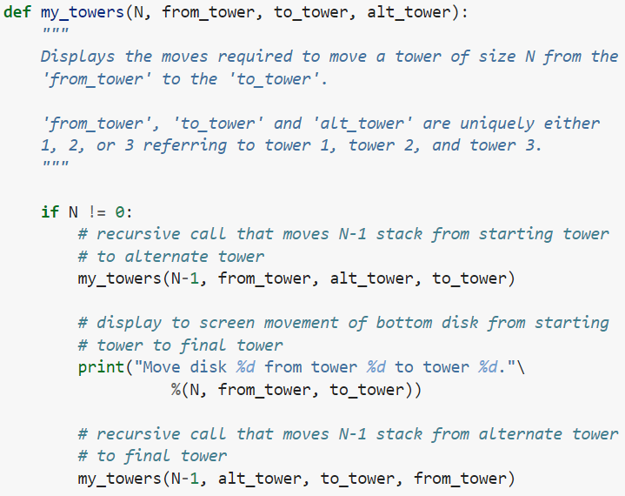
Towers of Hanoi
College of Engineering, Sungkyunkwan University

Slide 10
Towers of Hanoi
move (3, 1, 3, 2)
move (0, 2, 3, 1)
move (1, 2, 1, 3)
move (2, 1, 2, 3)
move (1, 1, 3, 2)
move (0, 1, 2, 3)
Move 1 from 2 to 1
5
Move 2 from 2 to 3
6
Move 3 from 1 to 3
4
Move 2 from 1 to 2
2
Move 1 from 1 to 3
1
move (0, 3, 1, 2)
move (1, 1, 3, 2)
move (2, 2, 3, 1)
move (1, 3, 2, 1)
move (0, 2, 3, 1)
move (0, 1, 2, 3)
move (0, 3, 1, 2)
Output:
Move 1 from 1 to 3
Move 2 from 1 to 2
Move 1 from 3 to 2
Move 3 from 1 to 3
Move 1 from 2 to 1
Move 2 from 2 to 3
Move 1 from 1 to 3
Move 1 from 1 to 3
7
Move 1 from 3 to 2
3
move (0, 2, 3, 1)
move (0, 1, 2, 3)
College of Engineering, Sungkyunkwan University

Slide 11

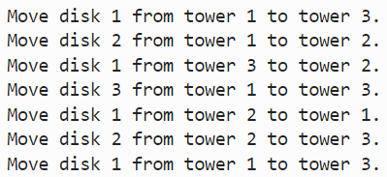
Towers of Hanoi
College of Engineering, Sungkyunkwan University

Slide 12
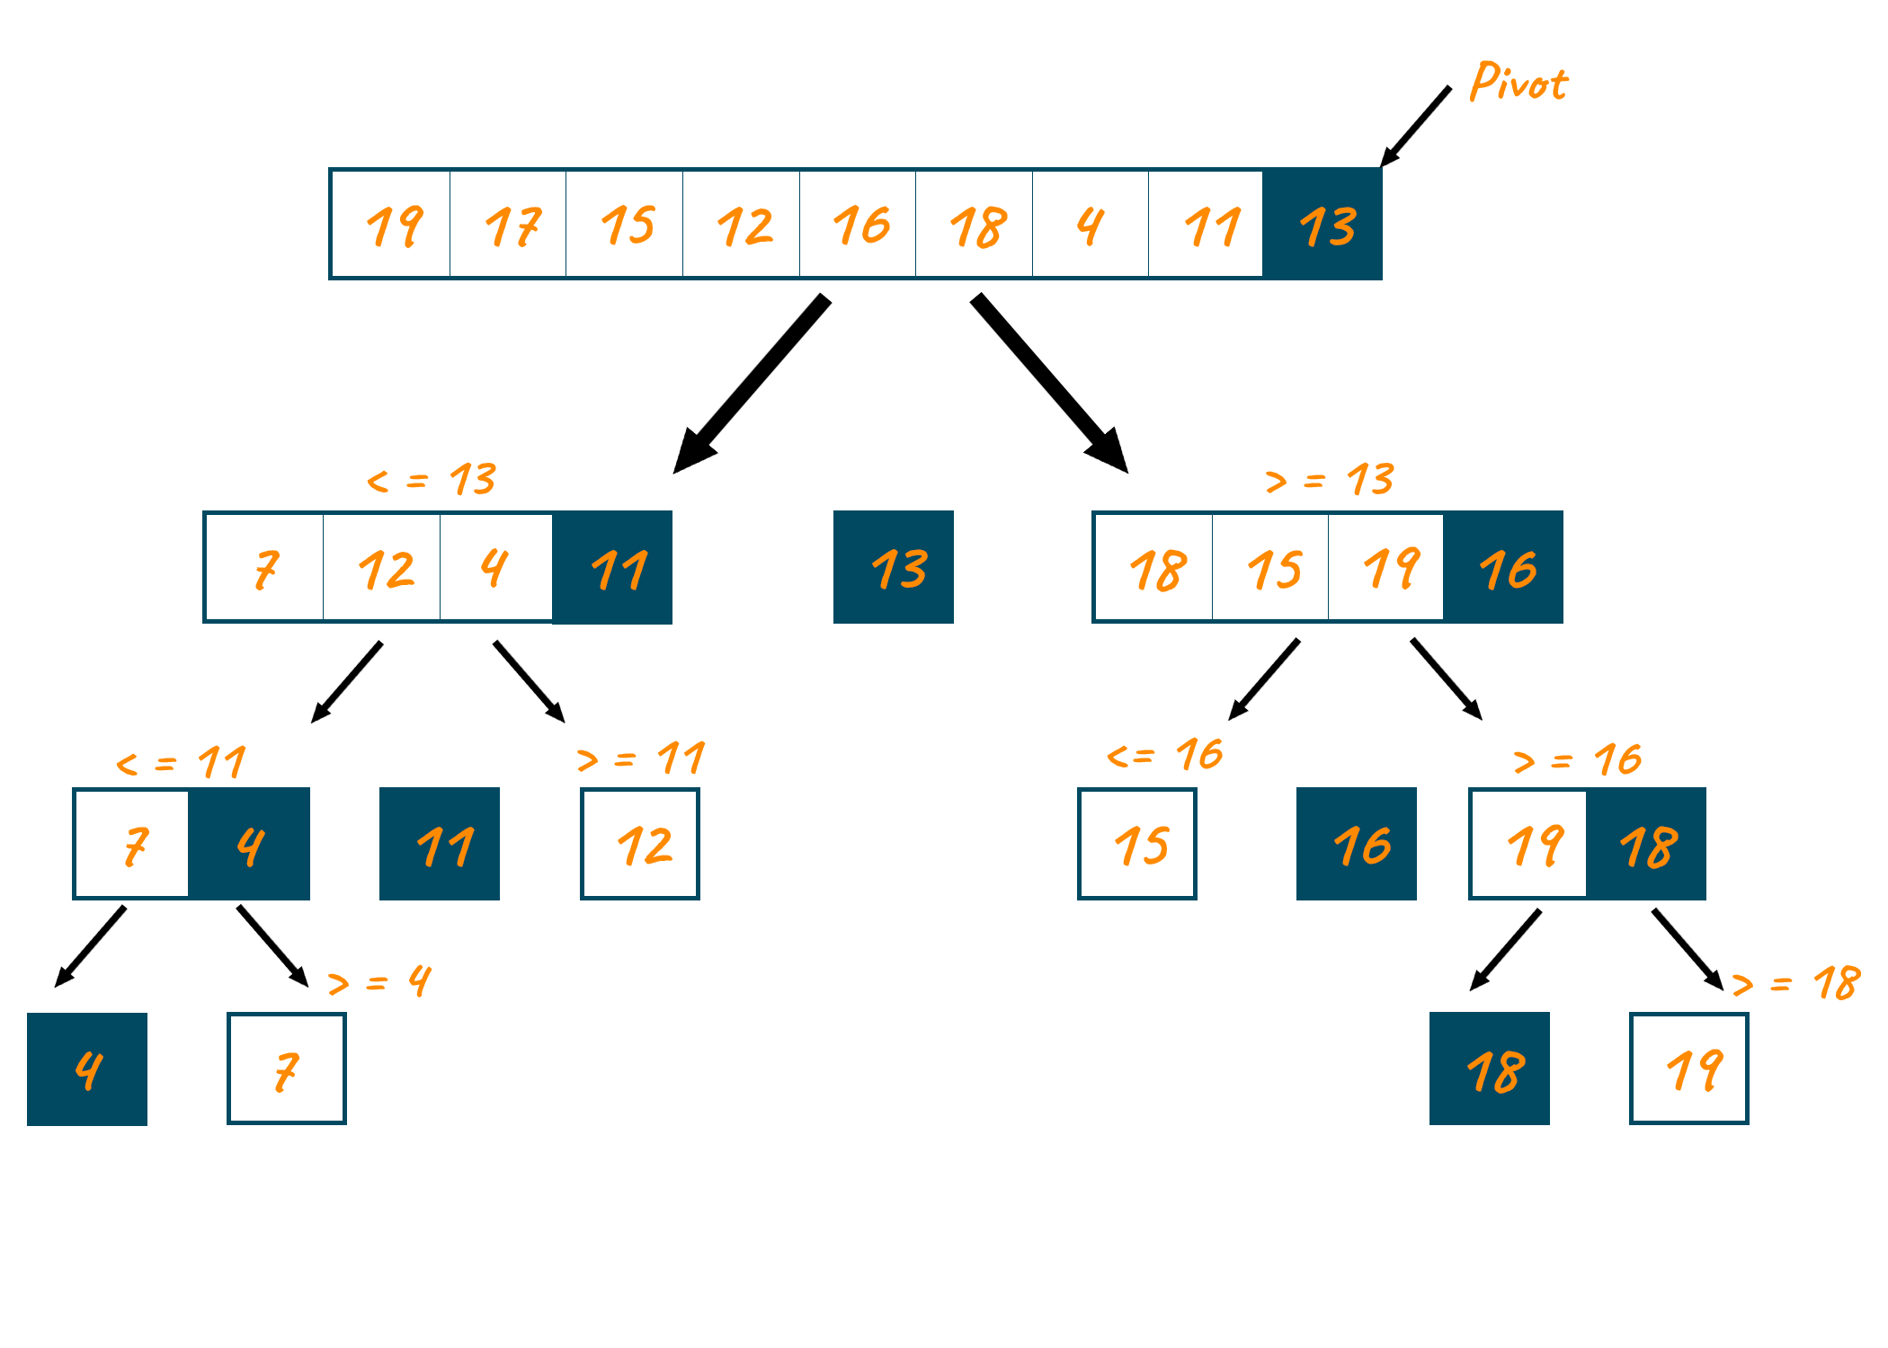
Quicksort
A list of numbers is given.
The aim is to sort the numbers in an ascending or descending order.
we separate the list by comparing to a pivot.
At each recursive call to quicksort, the input list is divided into three parts: elements less than the pivot, elements equal to the pivot, & elements greater than the pivot.
Then a recursive call to quicksort is made on the two subproblems
https://favtutor.com/blogs/quick-sort-cpp
College of Engineering, Sungkyunkwan University

Slide 13
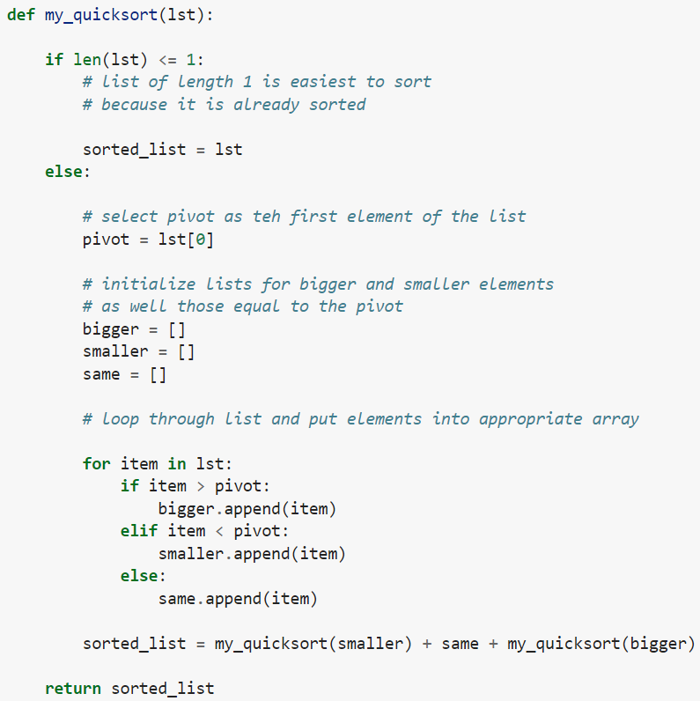
Quicksort
College of Engineering, Sungkyunkwan University

Slide 14

Quicksort
College of Engineering, Sungkyunkwan University

Slide 15


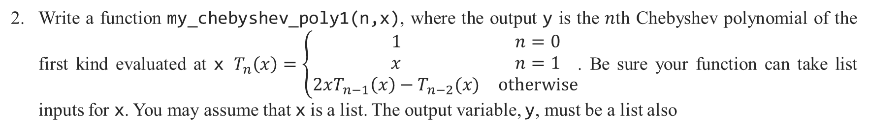
Assignment 5
Write a function my_sum(lst) where lst is a list, and the output is the sum of all the elements of lst. Use recursion to solve the problem, but do not use Python’s function sum.
Write a function my_chebyshev_poly1(n,x), where the output y is the $n$th Chebyshev polynomial of the first kind evaluated at x $T_{n}\left(x\right)=\left\{\begin{matrix}1 & n=0 \\ x & n=1 \\ 2xT_{n−1}\left(x\right)−T_{n−2}(x) & otherwise\end{matrix}\right.$. Be sure your function can take list inputs for x. You may assume that x is a list. The output variable, y, must be a list also
Test Case
College of Engineering, Sungkyunkwan University

Slide 16
Assignment 5
In purchases paid in cash, the seller must return money that was overpaid. This is commonly referred to as “giving change.” The bills and coins required to properly give change can be defined by a recursive relationship. The denominations of US currency, in dollars, is 100, 50, 20, 10, 5, 1, 0.25, 0.10, 0.05, and 0.01. For this problem we will ignore the 2-dollar bill, which is not in common circulation. Use recursion to program a function my_change(cost, paid) where cost is the cost of the item, paid is the amount paid, and the output change is a list of bills and coins that should be returned. You may assume that cost and paid are scalars, and that paid >= cost. The output variable, change, must be a list as shown in the test case.
Test Case
College of Engineering, Sungkyunkwan University

Slide 17
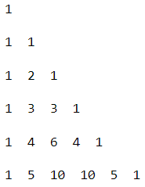
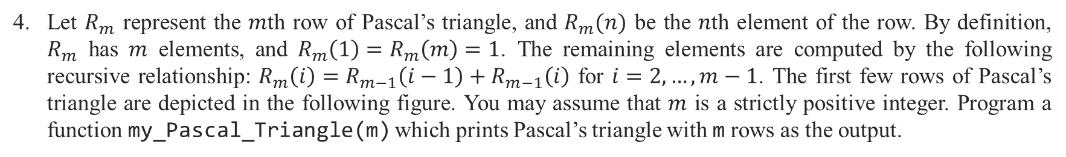
Assignment 5
Let $R_{m}$ represent the $m$th row of Pascal’s triangle, and $R_{m}(n)$ be the $n$th element of the row. By definition, $R_{m}$ has $m$ elements, and $R_{m}\left(1\right)=R_{m}\left(m\right)=1$. The remaining elements are computed by the following recursive relationship: $R_{m}\left(i\right)=R_{m−1}\left(i−1\right)+R_{m−1}\left(i\right)$ for $i=2,…,m−1$. The first few rows of Pascal’s triangle are depicted in the following figure. You may assume that $m$ is a strictly positive integer. Program a function my_Pascal_Triangle(m) which prints Pascal’s triangle with m rows as the output.
Test Case
College of Engineering, Sungkyunkwan University

